Slide 1
IDE Integration

Slide 2
Outline
IDEs
Importing
POM viewer
Dependency overview
Adding dependencies
Effective POM

Slide 3
Registry
Java / Maven installation
Bundled Maven Eclipse
https://www.eclipse.org
Installation

Slide 4
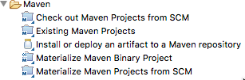
Maven integration
Default Goals Classpath
Importing

Slide 5
pom.xml
Convert to Maven Project Classpath
Converting

Slide 6
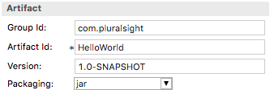
POM Viewer
Default View
High level elements Changes source

Slide 7
Manipulate dependencies
Dependency Management Add / Search screen
Dependencies

Slide 8
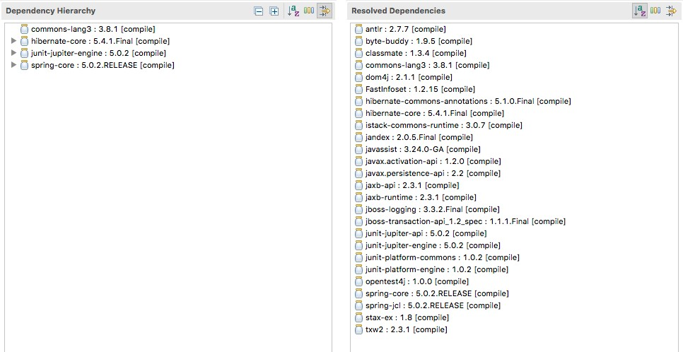
Dependency Hierarchy
Displays dependency tree, including transitive and overridden
Scope also displayed

Slide 9
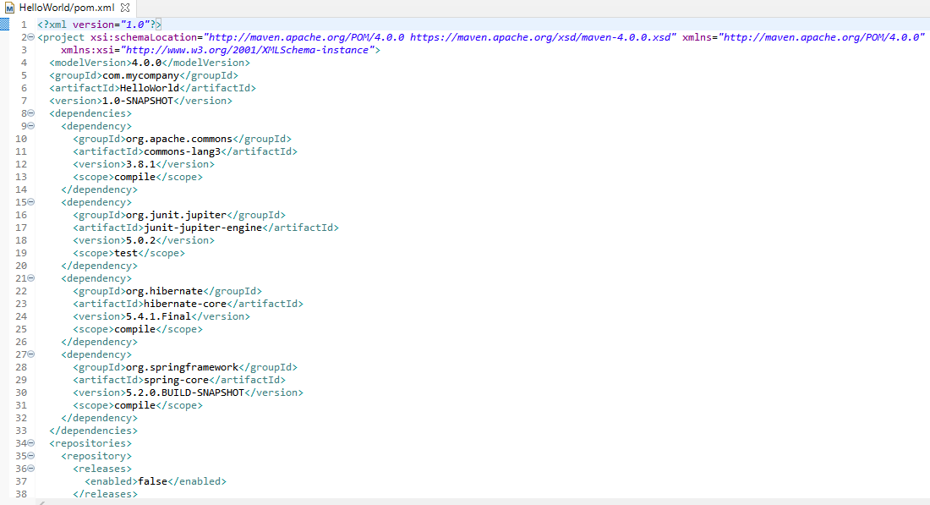
Effective POM
Complete POM, including inherited settings
Debugging tool

Slide 10
Summary
IDE installation
Adding dependencies Dependency Resolution IDE configuration

